Slide 1
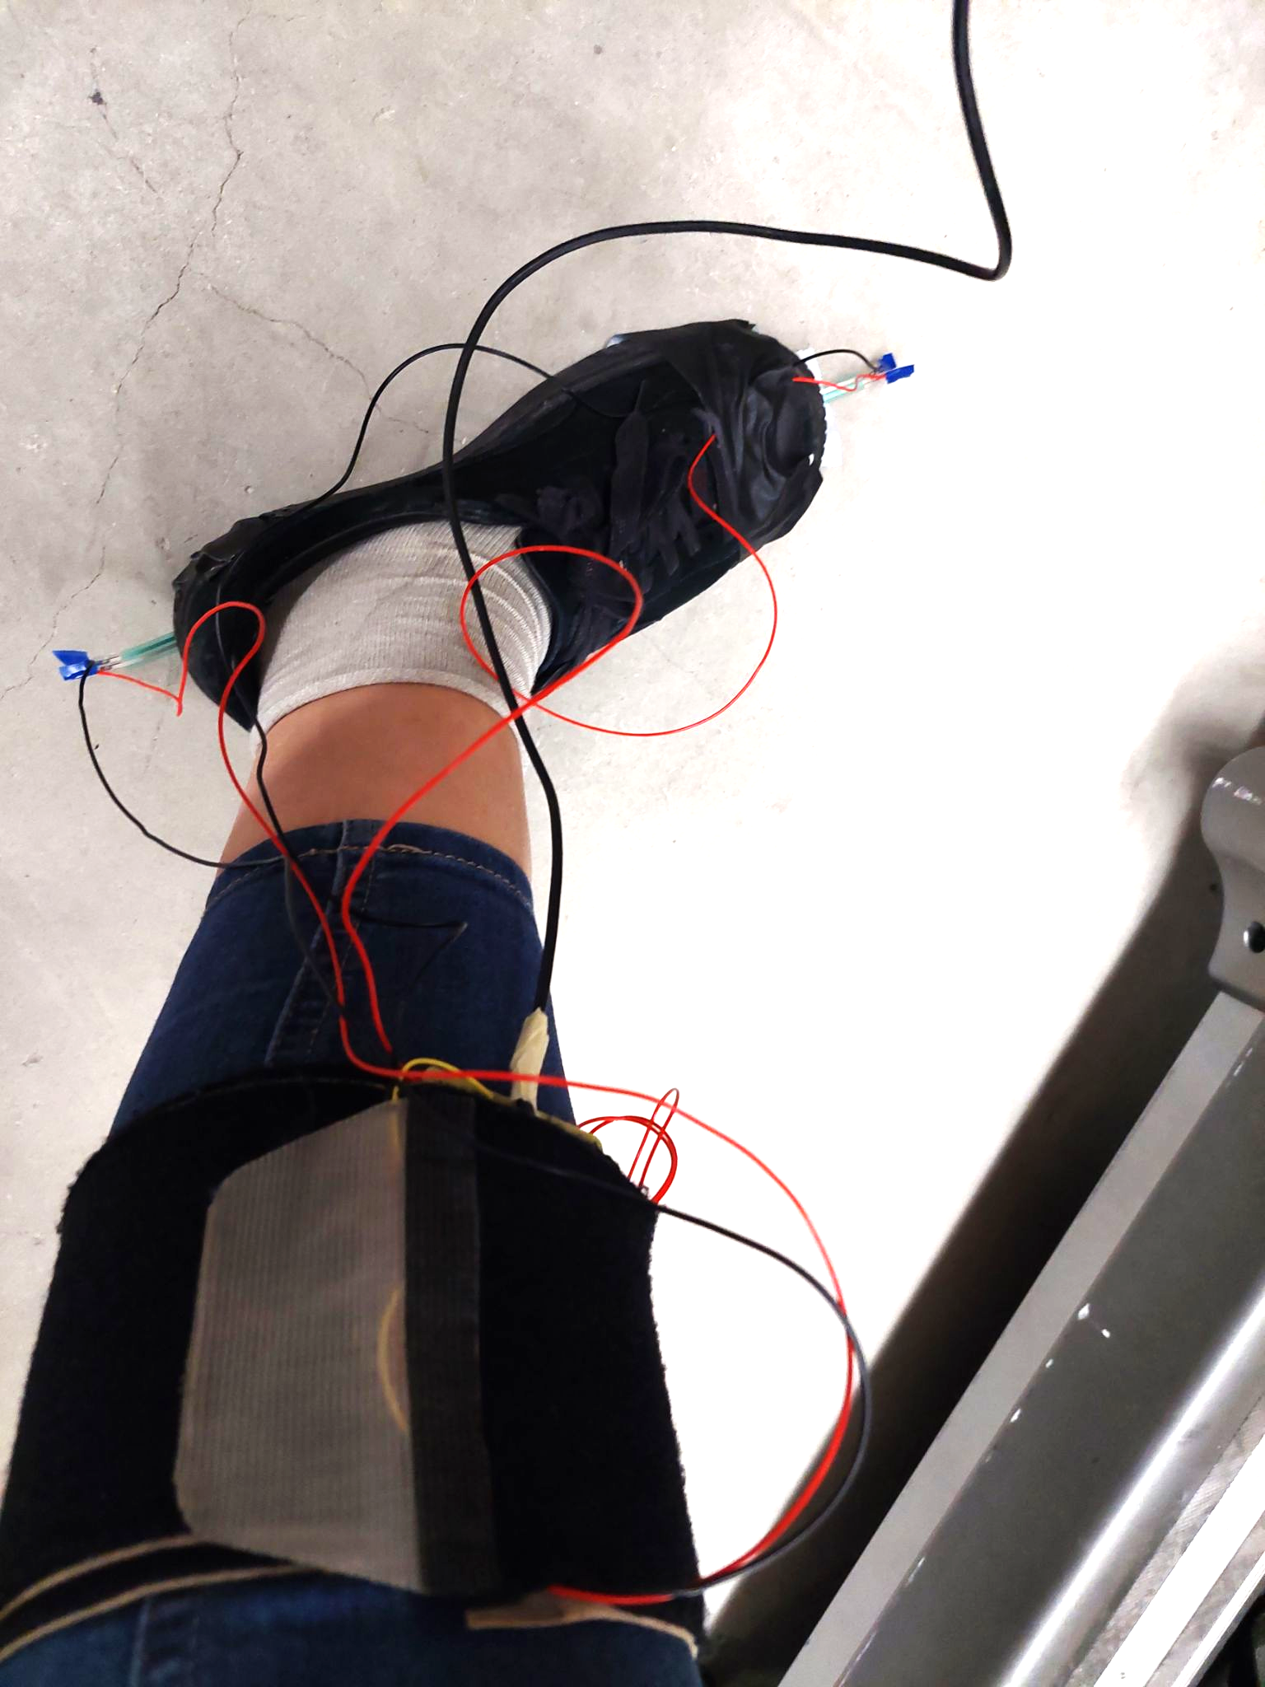
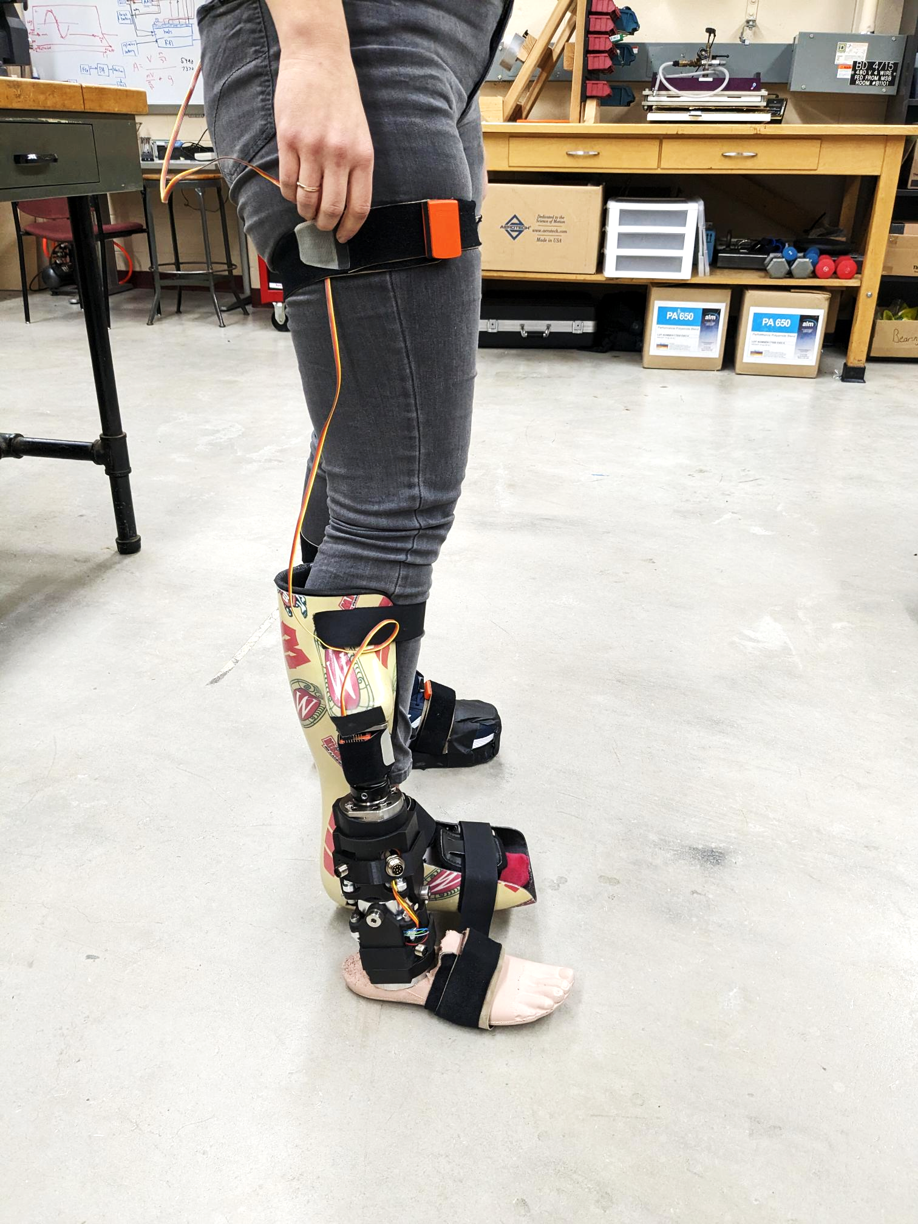
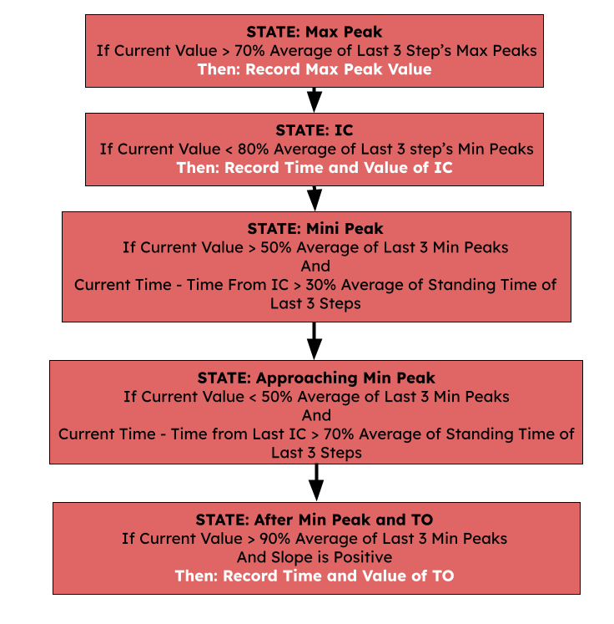
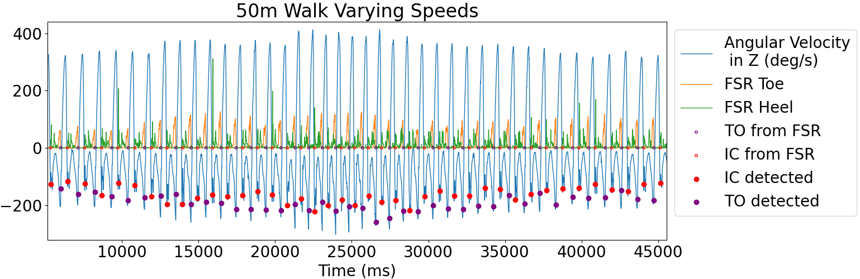
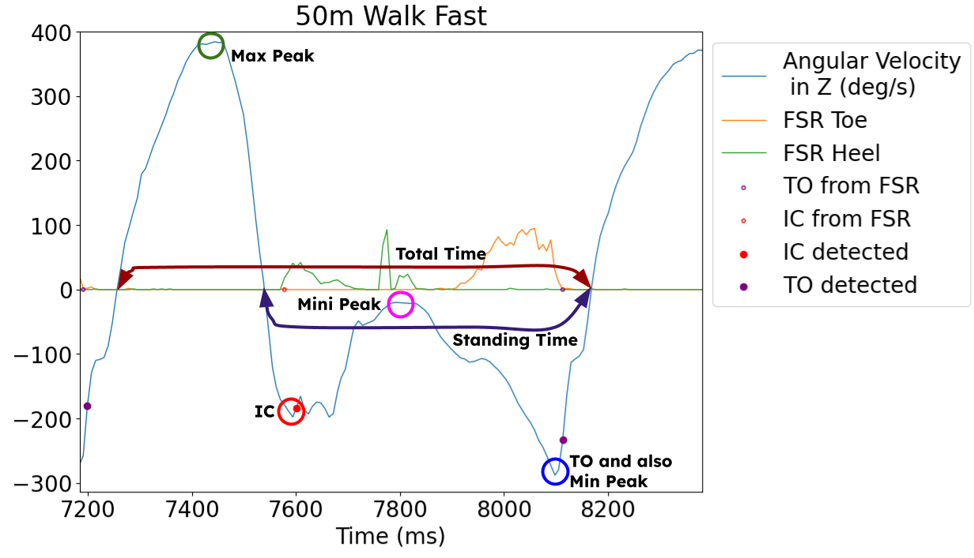
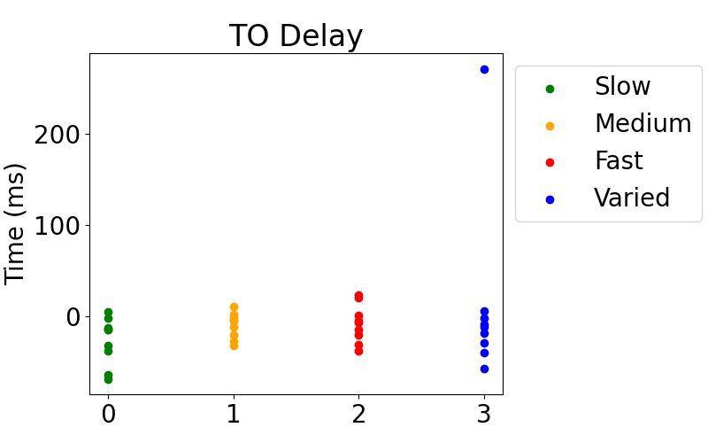
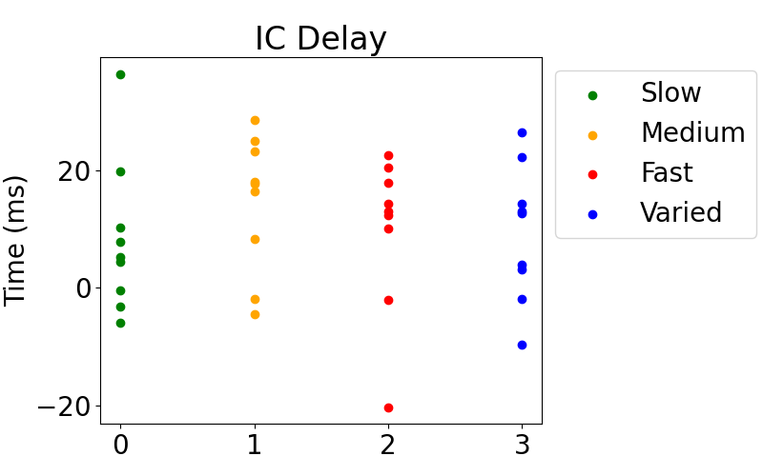



Comparing Algorithms for Real-Time Toe-Off and Initial Contact Detection in Prosthetic Technology
INTRODUCTION
Sofya Akhetova¹, Kieran Nichols², Rebecca Roembke², and Peter Adamczyk¹ ²
¹Electrical and Computer Engineering Department, University of Wisconsin Madison, Madison, WI, U.S.A.
² Mechanical Engineering Department, University of Wisconsin Madison, Madison, WI, U.S.A.
Email: akhetova@wisc.edu, knichols4@wisc.edu, rroembke@wisc.edu, peter.adamczyk@wisc.edu
Project’s github: https://github.com/akhetovasofya/RealTimeGaitDetection
TO: Toes-Off IC: Initial Contact
TADA is a semi-active prosthetic that mimics biological ankle's mechanical properties.
The goal of this research is to develop an adaptive algorithm for real-time gait phase determination.
Inertial measurement unit (IMU) readings from the shank are used for the algorithm.
METHODS
ALGORITHM DIAGRAM
ALGORITHM
Data was collected from 9 healthy participants without prosthetics.
Participants were asked to walk at slow, medium, fast, and varied speeds for 50m.
Two FSR sensors were attached to the bottom of a randomly selected foot for each participant.
The angular velocity from the SEEED's IMU was recorded to feed the developed algorithm.
Algorithm tracks swing and stance cycles based on sagittal-axis angular velocity measured by the IMU.
Five features are tracked: maximum peak, minimum peak, total time, standing time, TO, and IC.
We only keep track of the last three steps.
Those three steps are used to define the thresholds, thus allowing the algorithm to self-adjust itself as the person keeps walking.
We go through the states (on the diagram to the left) in the algorithm like in a state-machine: expecting one state after another, without the ability to jump between states that don’t have a connection in between each other (like arrows in the diagram).
There are other “if” statements in some states that help to output TO and IC even if those self-adjusting thresholds were not hit.
Our algorithm requires calibration and dynamically adjusts thresholds to accommodate variability in walking speed and pattern.
RESULTS
Our results show that we have an average of -8.08 ms delay for TO detection and 10.524 ms delay for IC. This is in range compared to the reported values in literature of 2.9-10.2 ms optimal IC latency with accelerometers [1], 10.7 ms IC latency with angular velocity [2], and -7.6 ms TO latency with angular velocity [2]. Furthermore, our algorithm has far better delay than pre-set fixed thresholds that have an average of 1137.7 ms for TO and 1373.7 ms for IC.
Mean Delay | Pre-Set Thresholds | Our Algorithm
TO slow | 4506.8 | -26.9
IC slow | 5197.3 | 8.3
TO medium | -278.1 | -9.6
IC medium | -18.4 | 14.5
TO fast | -315.3 | -7.9
IC fast | 28.3 | 9.8
TO varied | 637.6 | 12.2
IC varied | 287.6 | 9.3
TO | 1137.7 | -8.1
IC | 1373.7 | 10.5
CONCLUSION
Our algorithm shows promise for accurately detecting gait events in various walking patterns. It uses data patterns instead of fixed thresholds and adapts to the individual's unique gait. Ongoing work includes potential implementation of auto-regression to detect IC and TO events, and walking trials with stairs and turns.
REFERENCES
1. Hanlon et al 2009, Gait & posture, 30(4), 523–527.
2. Maqbool et al 2017, TNSRE, 25(9), 1500–1509

